Slide 1
Primary Hub Roadshow
October 2018
Notes:
This Roadshow has been compiled in October 2018 by Steven Fawkes for the ALL Primary Steering Group.
Previous Roadshows are archived here :

Slide 2
Notes
This presentation contains Notes below the screens, partly to save being too wordy.
Please do read them in advance as some of the information is essential to the screen content.
Notes:
There are no notes to this screen

Slide 3
Have you had refreshment?
We are very grateful to the Primary Hub coordinator for putting on this event, and to the host institution for their hospitality.
Please make a contribution to the cost of refreshments ☺

Slide 4
Contents
Have you heard about … Language Show Live?
Have you seen ... Primary Languages survey results 2018?
Have you heard about … NPLS 2018 ?
Have you seen ... RIPL?
Have you heard about … Language World 2019?
Have you thought about … EDoL competition?
Have you talked about … GDPR ?
Have you checked … your Hub details?
Have you talked about … local news and priorities?
Notes:
As ever you are welcome to use all, some or none of these screens in whichever order you like .
Feedback is welcome to steven.fawkes@gmail.com

Slide 5
Have you heard about … Language Show Live?
Language Show Live at Olympia London 9-11 November
ALL is supporting the free speaker CPD programme.
ALL has a stand and will be giving out
  copies of the Manual for THE LANGUAGE MAGICIAN to Primary Hub contacts.
  Information about ELAPSE – a new Erasmus+ Project
  If you intend to be there and to collect things please let us know.
Notes:
The full programme is here : https://languageshowlive.co.uk/talks/#teachers
Contact steven.fawkes@gmail.com

Slide 6
Have you seen .. survey of Primary Languages 2018
Clare Seccombe is a member of the ALL Primary Steering Group ; her latest Survey is here:
http://changing-phase.blogspot.com/2018/07/survey-2018-results.html
In November Clare represents ALL at a Primary Languages Summit on issues affecting implementation and progress.
If you have points to make about such issues please drop a line to Clare.
Notes:
Clare can be contacted at clare.seccombe@gmail.com

Slide 7
Have you heard about … NPLS 2018?
NPLS = Northern Primary Languages Show
especially for teachers in Primary (but all welcome!)
In lovely York on Saturday 1st December
Very special rates for ALL Members
Flyer / Programme here: https://forms.ncl.ac.uk/view.php?id=2611525
Booking here: https://forms.ncl.ac.uk/view.php?id=2611525
Notes:
This event promotes ALL membership and costs only £25 for ALL members, including refreshments and lunch

Slide 8
NPLS Programme includes
Janet Lloyd: Primary language learning power!
Workshops on Reading, Speaking, partnership working, Latin and Literacy, internationalism, writing and free resources and support from the Institut français and THE LANGUAGE MAGICIAN
Speakers : Suzi Bewell, Sue Balmer, Janet Clarke, Therese Comfort, Vicky Cooke, Helena Edwards, Benoit Le Dévédec, Steven Fawkes, John Rolfe, Clare Seccombe

Slide 9
Have you heard about … RIPL?
RIPL = Research in Primary Languages and the idea is to bring researchers and practitioners into closer cooperation.
Please pass on ideas for action-research projects or findings from any research-based activities that you are involved in
http://www.ripl.uk/
Notes:
Please contact steven.fawkes@gmail.com

Slide 10
Have you heard about … Language World 2019?
Call for papers is out on themes including:
• Nurturing our language teachers
• Celebrating languages
• Encouraging grammar approaches
• Motivating and inspiring learners
• Leading languages
• Planning for progression and transition
• Supporting bilingual learners
• Maximising progress and raising aspirations
• Using innovative approaches to technology
Early bird booking offer is open
https://www.all-languages.org.uk/news/language-world-2019-delegate-bookings-now-open/

Slide 11
EDoL writing competition
The 2019 competition run by ALLNE ‘A recipe (for happiness)’ produced a feast of entries, including lots from Primary learners!
Results will be out soon and we are planning an exhibition at Language World.
A few samples follow – thanks to all who helped their learners join in!
Notes:
The competition runs annually around EDoL – 26 September – and is open to school-aged learners from anywhere in the UK.
It is advertised in ALLNet and on social media.
The flyer for 2018 is here : https://www.all-languages.org.uk/events/competitions/european-day-of-languages-2018-a-recipe-for-hapiness/

Slide 12
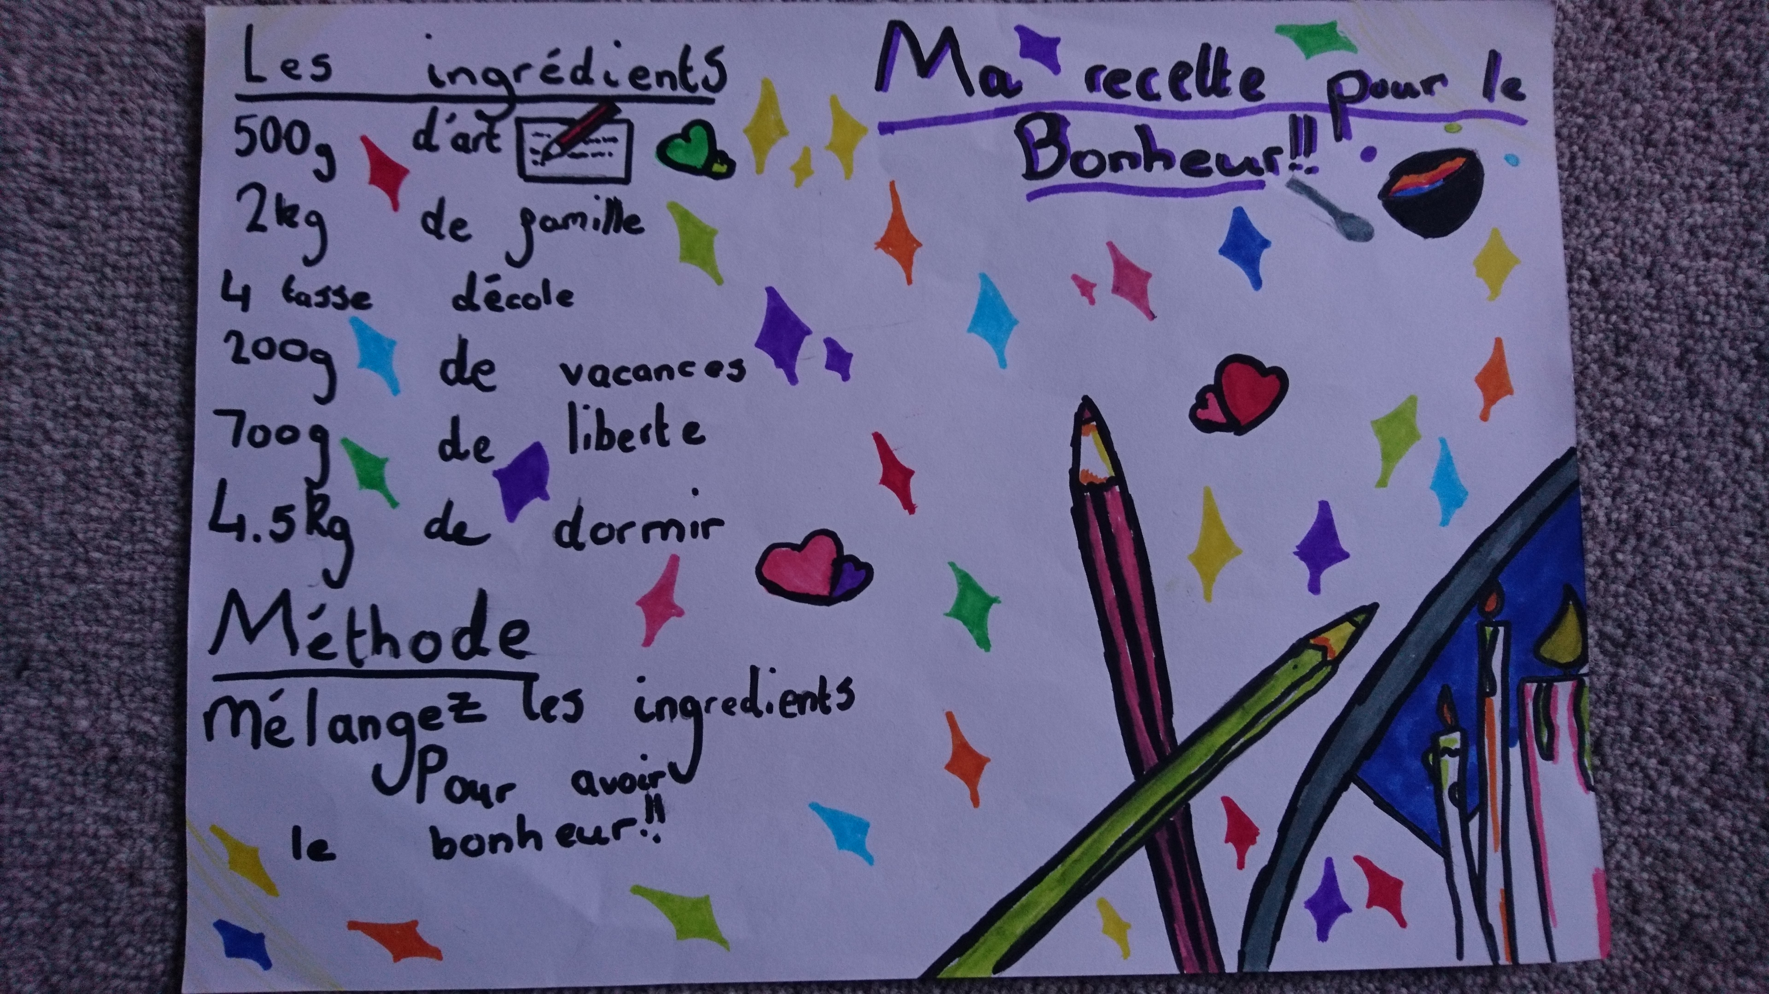
Random examples

Slide 13
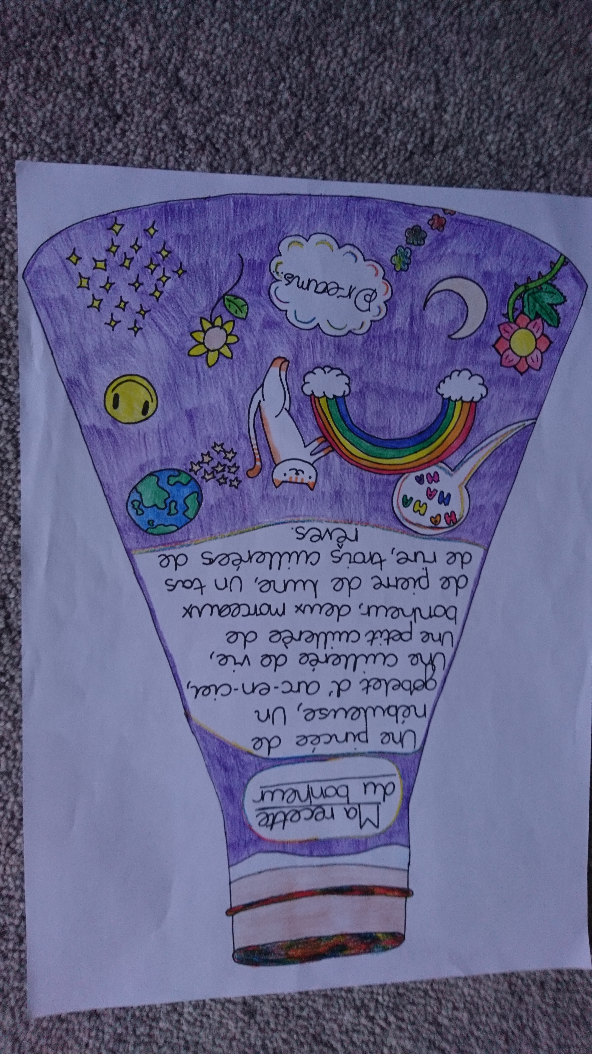

Slide 14
Classics / Latin
If your school is interested in either of these, please feel free to contact Sue Balmer who is the ALL Link person with Classics for all (who support that area of the Primary curriculum)
Notes:
Contact: sue.balmer@yahoo.co.uk

Slide 15
Have you visited … the ALL Literature wiki recently?
The wiki features all sorts of authentic texts recommended by other teachers – for all ages
Currently there is an Autumn focus on the home page: http://ALL-Literature.wikidot.com
There are weekly additions for Primary storybooks from Nathalie Paris

Slide 16
Have you talked about … GDPR ?
The General Data Protection Regulation is about protecting people’s personal data; along with other charities, organisations, schools and businesses ALL will comply with the Regulation
A few selected points about communications follow
Notes:
These are just pointers to clarify the main issues affecting ALL local groups and their members

Slide 17
GDPR and ALL-local members
ALL’s local groups usually correspond by email; messages sent to a group of ALL members will always protect email addresses by using the bcc (Blind Copy) field
Addresses will not be shared with third parties
Members can unsubscribe from email lists at any time on request
ALL’s Privacy notice for the whole Association is here : https://www.all-languages.org.uk/?s=privacy
Notes:
NB Hub Leaders sending out group emails – the requirement to use the bcc field is absolute. Any message which does not do this is a Breach of the Regulations and has to be reported There are very large fines imposable.
If you use your own group of email contacts you should include wording such as : You are receiving this email from a volunteer at ALL because of your interest in Language Education events and updates.
You can unsubscribe from them at any time by replying to a message.
Your email address will only be used for sending these messages (as blind copy - bcc) and will not be divulged to anybody else.

Slide 18
Have you checked … your Hub details?
Please check that details of your Primary Hub on this page are up to date
https://www.all-languages.org.uk/about/community/local/
Notes:
Pleas check contact details etc. and advise and changes to info@ALL-Languages.org.uk

Slide 19
Have you contributed?
Thank you for getting involved in this Primary Hub meeting, arranged by volunteers.
Please make a contribution to the cost of refreshments ☺

Slide 20
Reminders
ALL is:
The major professional association for teachers of ALL languages, at ALL levels, in ALL sectors;
Run by teachers, for teachers;
Completely independent - our sole purpose is to support and represent language teachers.

Slide 21
What does ALL do?
Represents the interests of its members;
Provides information and support;
Contributes to national debates;
Produces regular publications, such as Languages Today magazine and journals;
Runs training courses tailored to teachers’ needs;
Runs the annual Language World conference.

Slide 22
Why join ALL?
- To be well informed: Up to date with news and developments from the world of languages through our magazine, journals and weekly e-newsletter.
- To be networked: Part of the national community of language teachers in the UK, providing support and encouragement.
- To be adaptable: Discovering and applying new teaching methods, resources and technologies, from other teachers eager to share their practice.
- To be proactive: Taking control of your own professional development, and taking advantage of the many training events on offer.
- To be motivated: With regular boosts of ideas and inspiration, keeping you on the top of your game, and reminding you why you became a teacher!

Slide 23
What do members get?
Regular issues of Languages Today magazine;
Copies of ALLnet, our weekly e-newsletter;
Online access to our members’ area, and electronic issues of our journals;
Discounted or free training courses around the country, tailored to your needs;
Great special offers from our Corporate Members; and
Big discounts on delegate fees for our annual conference, Language World.

Slide 24
Primary membership
Heavily discounted
Currently just £50 per year
www.all-languages.org.uk/join/join_us/

Slide 25
How do I join ALL?
Online – at www.all-languages.org.uk;
By telephone – on 01332 227779;
By email – to info@all-languages.org.uk;
By post – to:
Association for Language Learning
1A Duffield Road
Little Eaton
Derby DE21 5DR
Notes:
This Roadshow was created in October 2018 by Steven Fawkes on behalf of the ALL Secondary Steering Group.
An archive is kept here : https://www.all-languages.org.uk/all-local/support-branches-networks-primary-hubs/

